Slide 1


Team G27
Own the Second Purchase
How we lift 90-day repeat from 24% to ~31%, inside the same $120M and with no discounts
Our retargeting and lifecycle plan, built on what we found in Adobe Customer Journey Analytics
Case Competition World Cup · Graduate Track · October 2026
Notes:
Quince's viral first buyers don't come back. We show how to win their second purchase inside the same budget.

Slide 2

We win the second purchase and lift repeat 24% → ~31%
G27
Situation Viral TikTok and Instagram moments brought Quince a huge wave of first buyers. Complication But CAC is up 29% to $62, only 24% buy again within 90 days (peers: 30–35%), and 60% of the fixed $120M goes to renting reach on social platforms.
Our answer: we blend all three options. Retargeting gets us moving, owned channels bring buyers back, CJA holdouts decide every dollar
Lever 1 Capture every buyer
Lever 2 Win the Golden Month
Lever 3 Never pay twice
Quince Passport
A box card registers the piece; SMS at checkout and app tracking let us reach everyone
Material Journeys
A care guide on arrival, then a second category by day 21, moving cashmere buyers into home
Never Pay Twice Engine
Daily CJA lists keep buyers we can already reach out of paid retargeting
66%
2.7×
23.0% vs 23.4%
of repeat buyers come from the 24.5% who engage; app users still come back at 21.5% after order one
more week-2 repeat for engaged buyers than for all buyers (directional: ~48 buyers a week)
retargeted vs organic repeat: the ads aren't buying loyalty
24% → ~31%
−12 to −14%
$9M re-aimed
90-day repeat, range 29.5‑33% · target +6 pts
blended CAC on Exhibit J's definition, $62 → ~$54 · target −10%
$7.5M goes to owned, net $0; +6 pts is worth ≈ $30M revenue a year (Exh. J)
Same $120M · No discounts, ever · We prove every move in Adobe CJA
Source: case sections 1, 3, Exhibits A, G, I, J; Adobe CJA A2, A3b, A5, A6, Cohort Table (appendix 9–13). The forecast is our base case (appendix 22); budget steps in appendix 21. Strict new-customer CAC ≈ −8% (appendix 26).
Team G27 · 2
Notes:
We want to own the second purchase, so we move up to nine million dollars from rented to owned channels, with holdouts deciding every dollar. Quince's viral growth built first buyers, but CAC is up 29% to 62 dollars and repeat sits at 24% against 30 to 35% at peers. Our answer is to blend all three options. With lever one we capture every buyer with the Quince Passport: the quarter of buyers who engage make up two thirds of repeaters. With lever two we win the golden month, when engaged buyers come back. With lever three we stop paying twice: retargeted buyers repeat no better than organic ones. The result: repeat goes from 24 to about 31%, blended CAC down 12 to 14% on Exhibit J's definition, inside the same 120 million, with no discounts.

Slide 3
Renting reach costs 29% more than two years ago, and it keeps the fewest customers
G27
THE MARKET
~$180B
US online apparel, accessories and home; growing mid-single digits (case, illustrative)
17.1%
of US retail sales were online in Q2 2026 (US Census)
+12.2%
e-commerce growth vs +6.7% for all retail (US Census)
FOUR FORCES RAISE THE COST OF RENTING REACH
RENTED CHANNELS COST MOST AND KEEP LEAST · EXHIBITS D, G (ILLUSTRATIVE)
35–50%
Signal loss
of iOS users allow tracking, so retargeting sees less
Share of the $120M
Avg. CAC
90-day repeat
Paid social prospecting
48%
$74
18%
+12%
Dearer auctions
Meta price per ad, year on year
Paid search
18%
$58
23%
Influencer / affiliate
13%
$52
21%
≥3×
Misread credit
how far ad-lift estimates are often off (Gordon)
Paid social retargeting
12%
$31*
22%
Organic / direct / SEO
not a paid line
$9
35%
44.8
Cautious consumer
record-low sentiment, so price can't be the answer
peers 30–35%
*Retargeting CAC counts media cost only; nobody has tested what it really adds (Exhibit D).
Organic is earned, not bought.
Owned channels are underfunded: app buyers repeat 38% and email/SMS 29% vs 13% web‑only; 3‑year LTV $410 vs $155. Yet owned gets 5% of the $120M.
Result for Quince: blended CAC
$48 → $62 · +29% in two years
So what: renting reach keeps getting dearer while owned customers keep paying back, so we move spend to owned inside the same $120M
Source: case §2, §3, Exhibits B, D, E, G, H (illustrative); US Census (Q2 2026); Adjust (Q2 2025); AppsFlyer (Apr 2025); Meta Q2 2026 results; Gordon et al. (2019); UMich Surveys of Consumers (May 2026). Links in appendix 27.
Team G27 · 3
Notes:
The market is big and moving online: about 180 billion dollars, with e-commerce growing almost twice as fast as retail. But four forces make renting reach dearer: only 35 to 50% of iPhone users can be tracked, Meta's price per ad is up 12%, attribution can overstate ad lift threefold, and with sentiment at a record low, price can't be the lever. Quince feels it: CAC is up 29%. And the channels it rents cost the most and keep the fewest customers, while owned customers repeat up to three times more and are worth 2.6 times as much. So we shift spend to owned, inside the same budget.

Slide 4




77% of carts stall, yet the 25% of buyers who engage make up 66% of repeaters
G27
Where the funnel breaks
Who comes back
When, and what next
People at each step (Fallout)
Repeat rate in the CJA window
Repeat orders in week 2 (Cohort)
Price signals quality: cashmere at half price can feel too good to be true (our hypothesis)
60,000
Engaged with email, SMS or app (A2)
Engaged
5.6%
28.1%
−69%
App after order one (A5, n=265)
All buyers
2.1%
21.5%
Half of engaged repeats land in weeks 1–4
36,566
SMS after order one (A5, n=315)
11.7%
Repeat by category touched (A6)
−77%
Home
20.8%
Not engaged (A2)
Jewelry
19.5%
11,339
4.7%
5,818
2,592
Beauty
18.5%
24.5% of buyers engage, yet they are 66% of repeat buyers (A2)
Cashmere
13.7%
Landing
Product
Cart
Checkout
Order
Only 1 of ~5,500 carts that stop before checkout gets a follow-up email (Flow)
Cashmere: touched by 40.7% of buyers, repeats least
Where the $120M goes
FY2026 (Exhibit G)
5% owned: $1.43 per active customer (A, G). $31 retargeting CAC is untested, and may count sales that would have happened anyway (D)
Prospecting $58M
Retarg. $14M
Search $22M
Infl. $16M
60% rented from social platforms
Owned $6M · Brand $4M
Source: Adobe CJA, Quince Case Data View, 1 Jan–30 Apr 2026 (Fallout A1, segments A2/A5, Flow A4, Cohort Table, A6), appendix 9–13; case Exhibits A, D, G. CJA repeat covers ~3 months, so we use it for relative gaps, not against the case's 24%.
Team G27 · 4
Notes:
Here's what we found in CJA. 69% of product viewers never add to cart, and 77% of cart adders never order; only one of about 5,500 cart paths that stop before checkout is followed next by an email. Buyers who engage with email, SMS or the app repeat at 28.1% versus 4.7%; after order one, app users still repeat 21.5%. Repeat orders peak in week 2, and cashmere, touched by 41% of buyers, repeats least. Yet the budget points the other way: 60% is rented from social platforms and 5% goes to channels Quince owns.

Slide 5





Rivals can copy a discount overnight, but not factory‑direct cost plus buyers who opted in
G27
Price vs depth of owned relationship (our judgment)
WHAT THREE RIVALS TEACH US
Paid reach is an auction we can't win
Amazon's ad business: $19.8B a quarter, +26%
target
Owned reach: % of buyers on app, email or SMS →
Owned channels alone aren't a moat
Everlane had strong email and SMS, and still ended up selling to Shein
CUYANA
today
Trust has to come from proof, not comparisons
Williams-Sonoma sued Quince over "dupes"
Value
Price →
Premium
What a rival can copy, and how fast
A 20% discount
Overnight
Journeys and suppression lists
Our move: straight up the map
We keep the factory-direct price and build the relationship rivals can't buy
A quarter or two
Factory-direct cost + opted-in buyers
Years
Source: case Exhibit M, section 7; Amazon Q2 2026 results; Bloomberg Law, NPR (May 2026); The Fashion Law (30 Sep 2026); Williams-Sonoma 10-K. Map positions and copy speeds are our judgment; full rival table in the case pack.
Team G27 · 5
Notes:
On competition: a rival can copy a 20% discount overnight and journeys in a quarter or two, but not factory-direct cost plus buyers who opted in. Amazon's ad business grew 26% to almost 20 billion dollars a quarter, so paid reach is an auction Quince can't win. Everlane had mature email and SMS and still sold to Shein, so owned channels alone aren't a moat. Williams-Sonoma sued over dupes, so trust must come from proof. Our move is simple: keep the price and build the relationship.

Slide 6





The customer data is ready; we close three gaps for $4.8M inside the owned line
G27
READY TODAY
How shipping events become journeys
Stitched person ID across web, app, email and SMS (Exhibit L)
Material Journeys, end to end (appendix 24)
Factories and 3PL
THREE GAPS WE FUND AS THE OWNED LINE GROWS $6M → $13.5M
Activation
CJA audiences to journeys and ad platforms
$1.5M
Month 3 · Marketing ops
Order and fulfillment events
Lifecycle team and creative
Today it's built for mass email blasts
$2.8M
Month 6 · CMO
Adobe CJA person ID
Journey Optimizer triggers
Growth–analytics alignment
Weekly holdout council; incremental scorecards
$0.5M
Month 3 · CMO + CFO
Owned channels
Partly there, and we fix it in the pilot: app tracking · 3PL order events · SMS consent split
The pilot runs on Option A's $2–3M inside today's $6M; the rest follows only as each step proves itself.
Source: case sections 1, 3, 4, 7; Exhibits A, I, K, L; costs, owners and dates from our plan (owned line $6M → $13.5M, appendix 21). Adobe CJA builds the audiences; Real-Time CDP or Journey Optimizer sends them out.
Team G27 · 6
Notes:
Can Quince do this? The data is ready: CJA already stitches one person across web, app, email and SMS. We see three gaps, and we fund each from the owned line: activation, so CJA audiences reach journeys and ad platforms, by month 3; a lifecycle team and creative, because today's email is built for mass blasts, by month 6; and one weekly holdout council so growth and analytics share one decision rule. On the right you can see how shipping events turn into journeys.

Slide 7
We test for 90 days in the South, and the first $4M moves only if the holdout proves it
G27
LEVER · WHY
IN THE SOUTH PILOT · SET UP WK 1–4, LAUNCH 5–8, MEASURE 9–12
GATE 1 PASS MARK, MONTH 3
OWNER · PAID FROM
Capture every buyer
77% of carts stall; only 24.5% of buyers engage
Quince Passport
Box card, SMS opt-in at checkout, order tracking in the app, and cart reminders at 1h and 24h
Engaged share ≥ 2× holdout
our aim: from 1 in 4 to 1 in 2 buyers engaged
CRM + app
Option A, inside $6M
1
Win the Golden Month
Repeat peaks in week 2; cashmere repeats least, 13.7%
Material Journeys v1
The delivery email sends a care guide; we suggest a second category by day 21
30-day repeat +2 pts vs holdout
read weekly on the CJA Cohort Table
CRM team
Option A, inside $6M
2
Never pay twice
Retargeted buyers repeat 23.0%, same as organic 23.4%
Never Pay Twice Engine
Every day we send Meta, Google and TikTok the buyers we can already reach, so they stop seeing ads
Orders per $ ≥ holdout
guardrail: new customers drop by less than 2%
Paid media
$14M line, $0 extra
3
THEN WE MOVE MONEY ONLY WHERE THE HOLDOUT PROVES IT · 14 PROGRAMS, 0 DISCOUNTS
South pilot
Weeks 1–12 · 10% holdout
3 flagships; 11 programs wait
Retargeting → owned
Month 3 · $4M
if Gate 1 passes
Search → owned
Months 4–6 · $3M
if the branded geo test proves it
Prospecting → owned
Months 7–9 · up to $2M
only if it's shown to be over-credited
Gate 2 → target
Month 9 ≥ 28%
~31% repeat by month 18
Source: case Exhibits G, I, N; Adobe CJA A1, A2, A3b, A6, Cohort Table; our plan. 3 flagships in the pilot; 11 more programs wait for Gate 1 (appendix 20). We start in the South (fastest new-customer growth, lower email/SMS opt-in, Exhibit N), then the Midwest.
Team G27 · 7
Notes:
Here's how we start: a 90-day pilot in the South, with a randomized 10% holdout. Lever one launches the Quince Passport, app tracking and saved-cart reminders; lever two the first Material Journey; lever three daily suppression lists inside the existing retargeting line. The pilot runs on Option A's two to three million inside today's owned budget. At month 3, Gate 1 asks for two points of 30-day repeat over the holdout, twice the holdout's engaged share, and new customers down less than 2%. If it passes, four million dollars of retargeting moves to owned. Months 4 to 6, branded search can move three million; months 7 to 9, up to two million of prospecting, only if proven. Gate 2 at month 9 checks 28%, on the way to about 31% by month 18. So our ask is simple: own the second purchase, moving up to nine million dollars from rented to owned, with holdouts deciding every dollar.

Slide 8
Appendix
ADOBE CJA EVIDENCE
BACKUP ANALYSIS
9
Fallout
14
Why a blend
21
How the $120M moves, line by line
10
Attribution IQ
15
Issue tree
22
Path to ~31% repeat
11
Cohort Table
16
Seven moments of the journey
23
Attribution IQ insight
12
Flow
17
Every cart adder's path (flowchart)
24
Material Journeys build plan
13
Segments
18
Never Pay Twice engine
25
Risks
19
The weekly CJA loop
26
Every number and its source
20
Fourteen programs, explained
27
Sources
Team G27 · 8
Notes:
Quince's viral first buyers don't come back. We show how to win their second purchase inside the same budget.

Slide 9
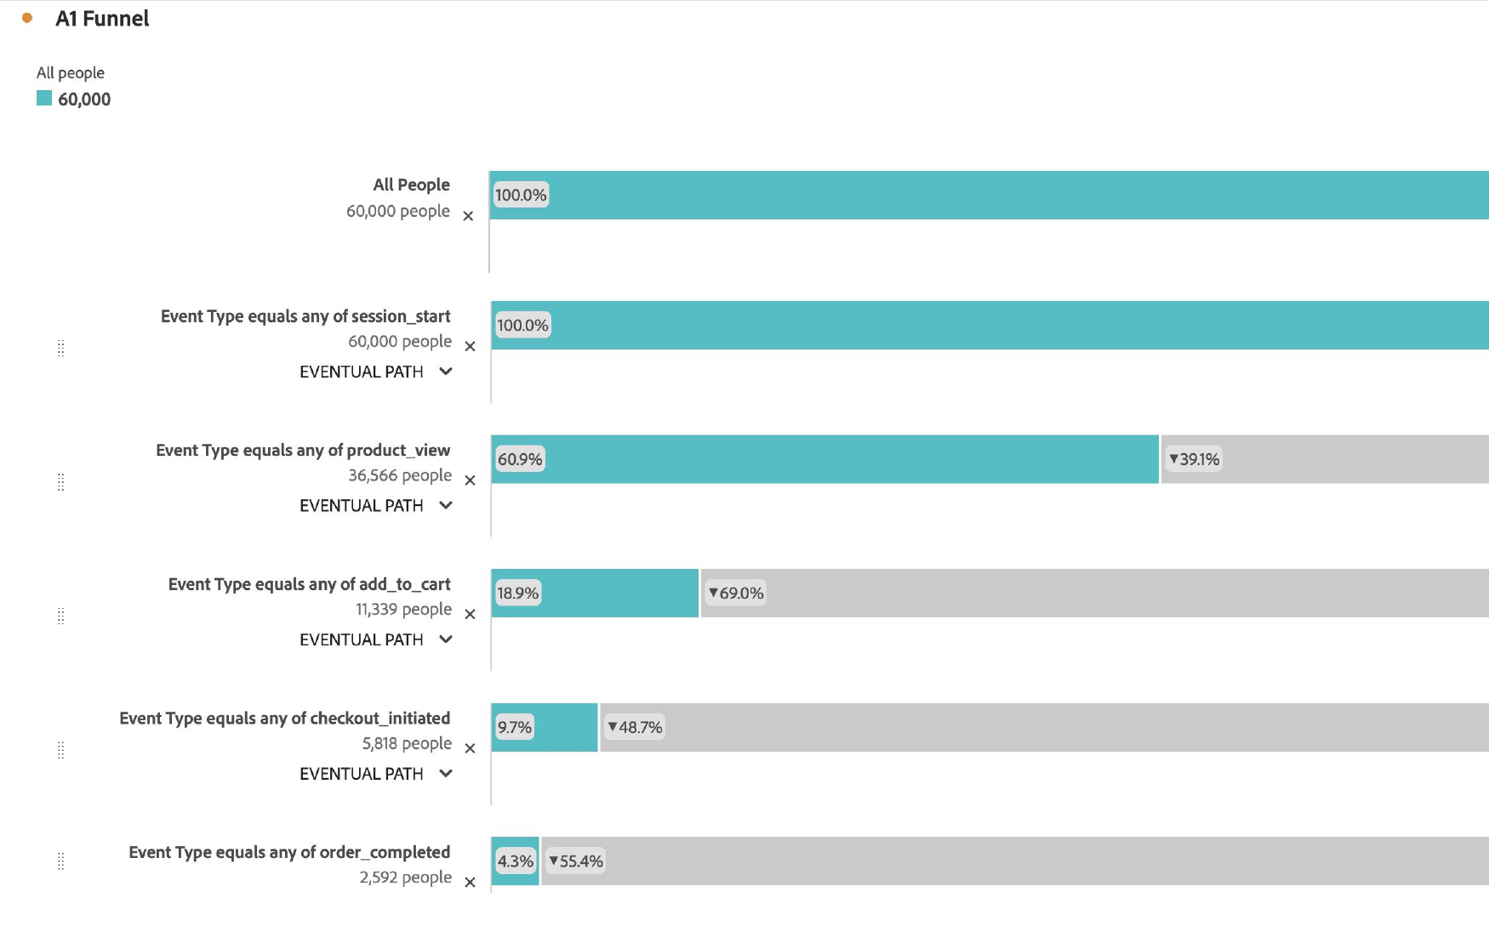

77% of cart adders never order
G27
77% of cart adders never order, against a ~70% category benchmark (Exhibit C). The cart is where Quince falls behind, so recovering carts is our fastest test
Source: Adobe CJA, Fallout, Quince Case Data View, 1 Jan–30 Apr 2026, 60,000 people. 69% of product viewers never add to cart.
Team G27 · 9

Slide 10
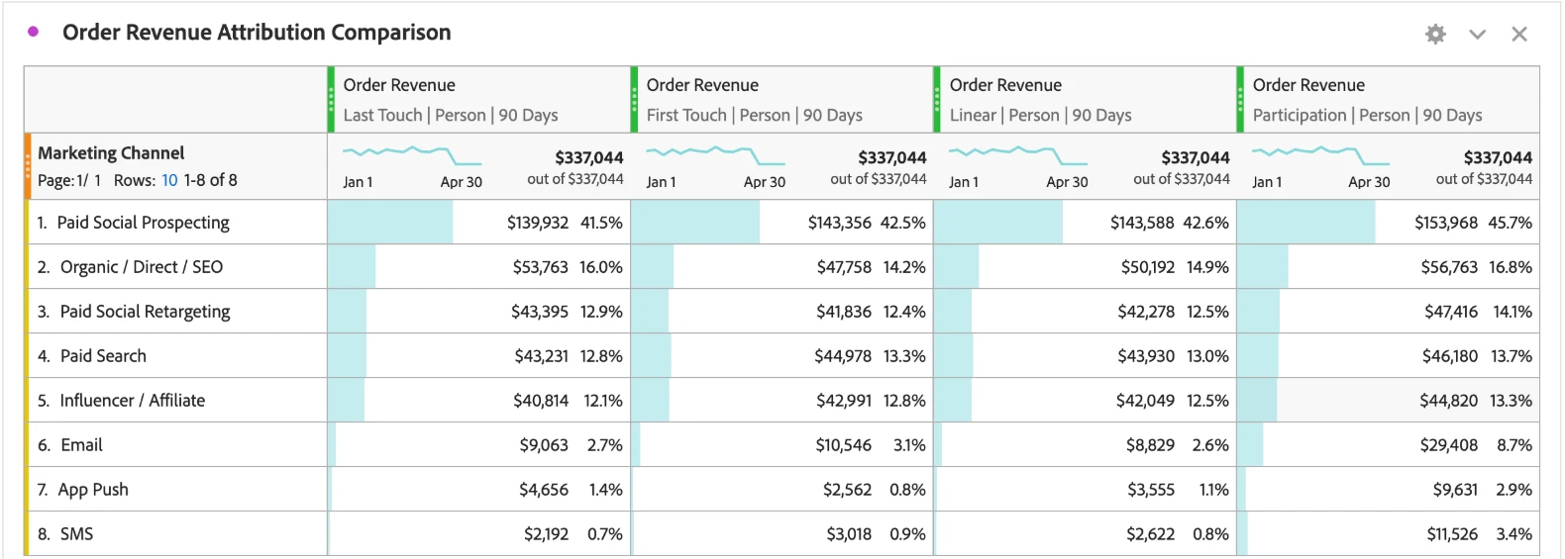
Standard attribution can't tell us what retargeting really adds
G27
Last touch, first touch and linear give owned channels ~5% (4.8 · 4.8 · 4.5%) and retargeting ~12.5% (12.9 · 12.4 · 12.5%). Attribution can't rank them, so we let holdouts decide the budget
Source: Adobe CJA, Attribution IQ, Order Revenue ($337,044) by Marketing Channel; Last Touch, First Touch, Linear, Participation; 90-day lookback. Algorithmic model unavailable on this view; Participation is not a credit model.
Team G27 · 10

Slide 11
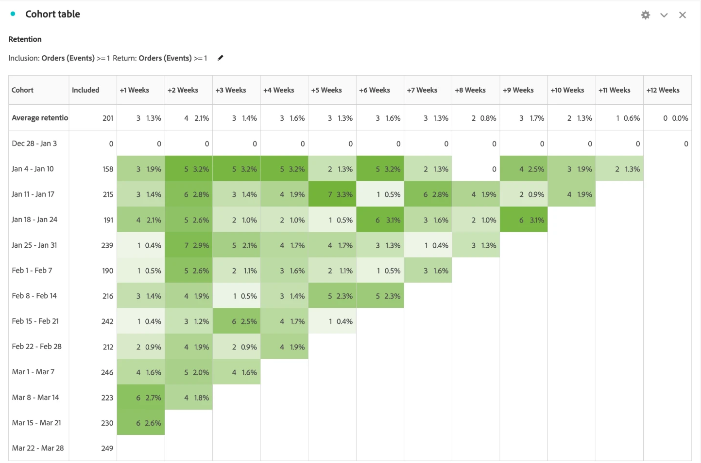
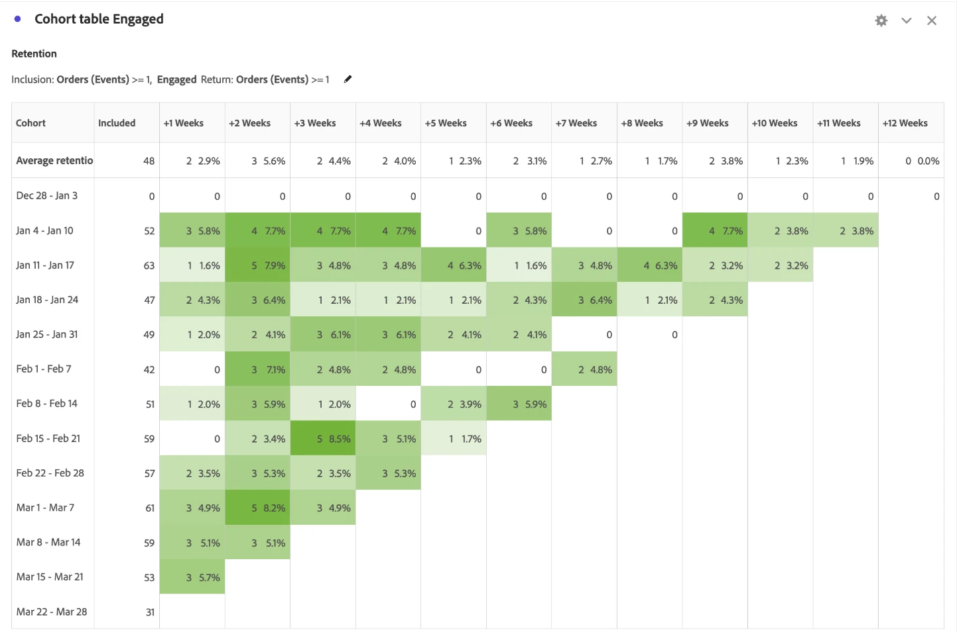
Engaged buyers repeat 2.7x more in week 2
G27
All buyers
Engaged buyers (inclusion segment)
Engaged buyers repeat 2.7× more in week 2 than all buyers (5.6% vs 2.1%), and half their repeats land in weeks 1–4. Cohorts are small (~48 engaged buyers a week), so we read this as directional
Source: Adobe CJA, Cohort Table, inclusion and return Orders ≥ 1, weekly, 1 Jan–30 Apr 2026; right panel uses the Engaged inclusion segment.
Team G27 · 11

Slide 12
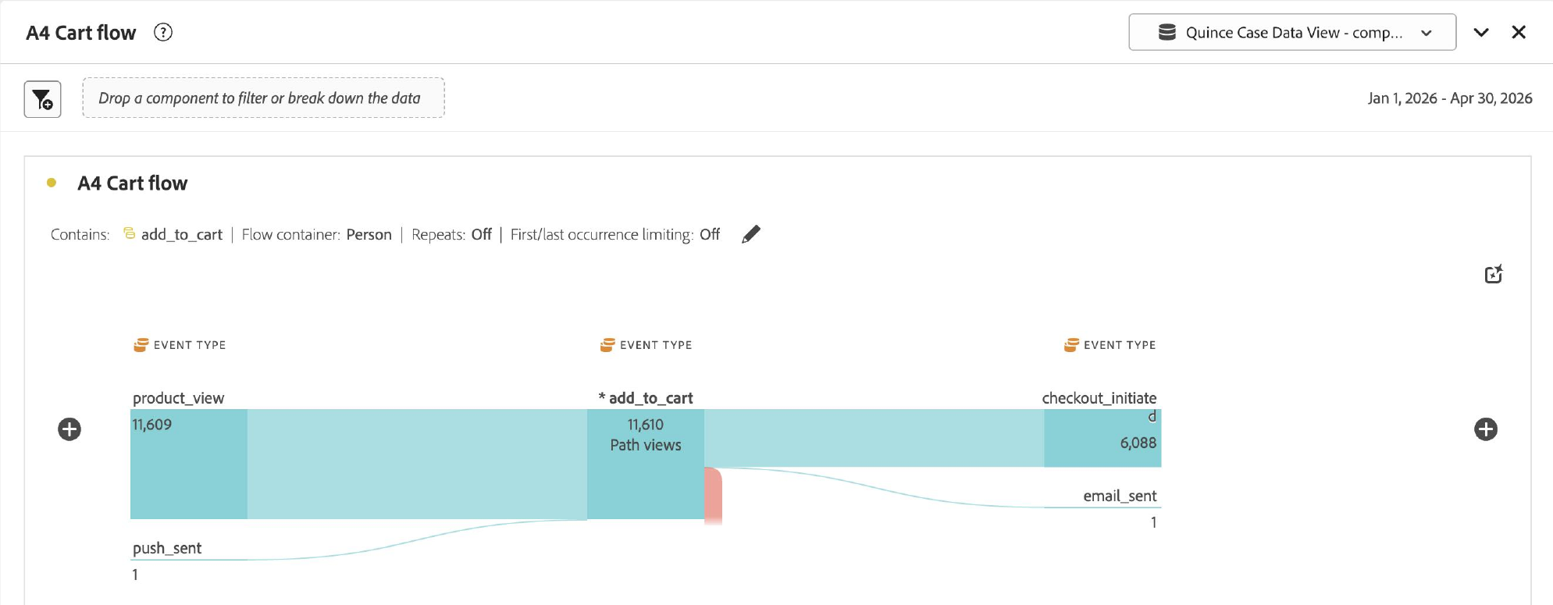
Almost no stalled cart gets a follow-up email
G27
Of 11,610 cart paths, 6,088 go on to checkout and only 1 is followed by an email. A simple cart reminder is our fastest win
Source: Adobe CJA, Flow from add_to_cart (next step), Person container, 1 Jan–30 Apr 2026. 11,610 = path views; 11,339 = people (Fallout).
Team G27 · 12

Slide 13
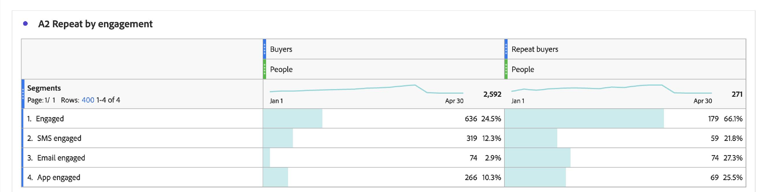
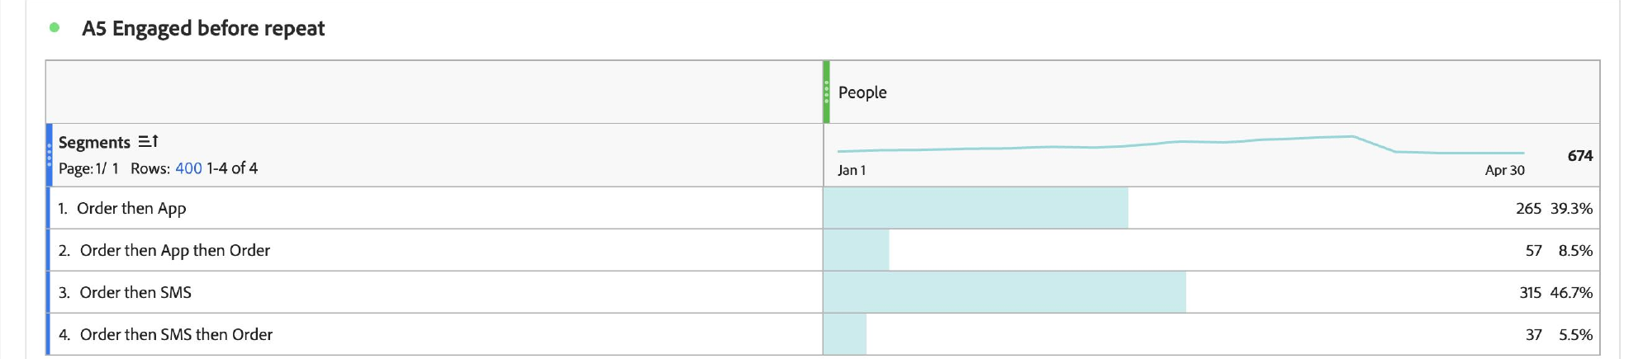
App users come back at double the rate of SMS users
G27
A2 · Repeat by engagement (any time)
A5 · Engaged after order one
Engaged buyers are 24.5% of buyers but 66% of repeaters (A2 overstates this, since owned visits only log at purchase). After order one, app users still repeat 21.5% vs 11.7% for SMS (A5, the cleaner test)
Source: Adobe CJA, freeform tables with engagement segments (A2) and sequential segments after order one (A5, n = 265 app, 315 SMS), 1 Jan–30 Apr 2026.
Team G27 · 13

Slide 14


Why we blend paid speed with owned retention
G27
B
Option B
A
Option A
C
Option C
Paid precision and suppression
Owned lifecycle precision
Attribution-based reallocation
Results in weeks, $0 incremental
Lowest cost per touch; insulated from ATT
The way we decide, for good
On its own: exposed to signal loss, and builds no lasting relationship
On its own: limited to today's list, where only 1 in 4 buyers engage
On its own: 6–12 months before anyone trusts it, and hard to adopt
Proves fast
Savings held in the $14M line until a holdout proves them
Builds it
Capture grows the list; journeys earn order two
Proves it
Runs from day 1 and decides every tranche
B gives us fast proof, A's owned reach shields us from B's signal loss, and C's holdouts tell us whether either is working
We scale only what beats the CJA holdout, and stop anything that doesn't
Source: case section 4 (Options A, B, C), Exhibit I (cost and timing) and Exhibit K (risk matrix); our analysis.
Team G27 · 14

Slide 15
Four root causes behind the 24% repeat rate
G27
Money
Spend may pay for demand that comes anyway
Never pay twice
Retargeted buyers repeat no better than organic: 23.0% vs 23.4% (A3b); a holdout will tell us
Customer mind
One-product buyers
Why is 90-day repeat 24% and blended CAC $62 on a fixed $120M?
Win the Golden Month
Cashmere is touched by 40.7% of buyers but repeats 13.7% (A6)
Customer journey
The purchase leaks
Capture every buyer
77% of cart adders never order; 1 of ~5,500 cart paths stopping before checkout gets an email (A1, A4)
Brand trust
Found, not yet trusted
Trust thread, all levers
25,227 people leave after a product view (A1)
Repeat = engaged share × engaged repeat + non-engaged share × non-engaged repeat; CAC = $120M ÷ new customers
Source: our analysis; Adobe CJA panels A1–A6 and A3b; case Exhibits D and G.
Team G27 · 15

Slide 16







We ask for the relationship when the box opens
G27
Discovery
Product page
Cart
Checkout
Delivery
Days 0–30
Days 30–90
45.5% via prospecting
25,227 leave here
77% never order
App 27.1% vs web 22.7%
24.5% engage (A2)
Week-2 peak 5.6%
Cashmere 13.7%
Mechanism
Mechanism
Mechanism
Mechanism
Mechanism
Mechanism
Mechanism
Social proof
Price signals quality
Unfinished task fades
Default effect
Peak-end, endowment
Habit formation
Mental accounting
Loyalist Lookalikes
Proof Creators
Saved Cart
Track It in the App
Quince Passport
Care Calendar
Material Journeys
Trust peaks when the parcel opens, so that's when we ask for the relationship, never with a discount
Source: Adobe CJA panels A1, A2, A4, A5, A6 and Cohort Table; the mechanisms are our hypotheses, and the pilot tests them.
Team G27 · 16

Slide 17

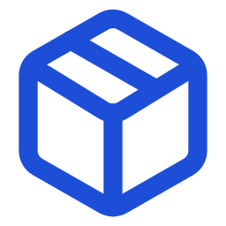






Every cart: owned channels first, paid second
G27
Repeat buyer
Quince Insider early access
Order ships
Passport card in the box; tracking opens in the app
Engaged after order one?
Golden Month, weeks 1–4
Care and fit, then a second category; cashmere → Material Journeys by day 21
Yes
Yes
Second order by day 60?
Yes
No
Off retargeting; max one reminder
Shopper adds to cart
Orders?
Not engaged yet
One ask at delivery, day 7, day 21; without marketing consent, one capped paid reminder
No
Day 60
Restock-first access
orders later → joins the top path
No
Reachable by email, SMS or app?
Yes
Saved Cart
Reminder at 1h and again at 24h; never a discount
LEGEND
Saved CJA segment test
Start and outcome
Paid retargeting, days 1–7
Capped; the one job we leave to retargeting
Owned channel: app, email, SMS, box
After day 7: stop
Paid media
No
Removed from paid media
Each diamond is a saved CJA segment, so the same rule sends the message and measures it
Source: Adobe CJA segments (A1, A2, A4, A6, Cohort Table); our targeting design. Message timings are our pilot choices, tested against the holdout.
Team G27 · 17

Slide 18



We stop paying for ads to customers we already have
G27
DATA IN
IDENTITY
AUDIENCES IN CJA
ACTIVATION, DAILY
OUTCOME
Recent buyers
ordered in the last 30 days
Suppression lists
to Meta, Google and TikTok daily, via Real-Time CDP
Every touchpoint
Web and app events, email, SMS and paid-media touches: 125,521 events in the CJA view
One stitched person ID
The same customer across web, app, email and SMS; ready today (Exhibit L)
Retargeting's one job
reaching interested shoppers we have no other way to contact, inside the same $14M line ($0 extra, Exhibit I)
Owned-reachable
has email, SMS or the app
Frequency cap
per person, across platforms
Single-page bouncers
lowest intent: left after one page
Prospecting exclusions
existing buyers kept out of new-customer campaigns
Prove: incremental orders per retargeting $ vs holdout
Why test it: retargeted buyers repeat no better than organic (23.0% vs 23.4%, A3b) and attribution barely moves, so only a holdout can show what retargeting is worth. We leave the prospecting budget, which brings 45.5% of buyers, unchanged.
We stop paying to reach customers we can already message; the prospecting budget stays the same
Source: Adobe CJA, Quince Case Data View (125,521 events, 1 Jan–30 Apr 2026), segments A3b and A1; case Exhibits D, I, L; our design.
Team G27 · 18

Slide 19
Our weekly loop: how analytics and growth work together
G27
1
Diagnose
2
Target
3
Activate
4
Prove
5
Reallocate
Option C
Options A + B
Options A + B
Option C
Option C
Read Fallout, Flow, Cohort Table and Attribution IQ on one stitched person ID
Turn findings into saved CJA segments: abandoners, engaged, cashmere-first, recent buyers
Send segments to lifecycle journeys and to paid-media suppression lists
Read every move against a randomized holdout: 10% in the South pilot
Move money across lines only when the holdout proves it; otherwise it stays
OWNER Head of Analytics
RHYTHM Weekly
OWNER Analytics + CRM
RHYTHM Weekly
OWNER Marketing ops
RHYTHM Daily sync
OWNER Head of Analytics
RHYTHM Weekly council
OWNER CMO + CFO
RHYTHM Gates: months 3, 9
What CJA proves tells us where to look next and what to do next
Why it matters: On its own, Option C takes 6–12 months to trust (Exhibit I). Running it as a weekly loop from day one lets A and B act within weeks, while C decides every budget move.
Growth and analytics share one workspace, one holdout and one way of deciding
Source: case section 4 (Options A, B, C), Exhibits I and L; owners and rhythm are our operating design.
Team G27 · 19

Slide 20
14 programs, zero discounts, no new budget
G27
1 Capture every buyer
2 Win the Golden Month
3 Never pay twice
Quince Passport
A card in every box: scan it to register the piece for care tips, easy exchanges and restock alerts, and we ask for SMS or the app
Material Journeys
Before it arrives, we explain how the material is made and how to care for it (no supplier names); by day 21, a second category (cashmere → home)
Never Pay Twice Engine
Daily CJA lists tell Meta, Google and TikTok which buyers we can already reach, so we stop paying to retarget them
Track It in the App
Order tracking opens in the app, where carts convert at 27.1% vs 22.7% on web (A1)
Care Calendar
Seasonal care reminders keep us in touch with cashmere buyers
Loyalist Lookalikes
We model new prospects on repeat buyers, not one-time buyers
Gift Ledger
Customers save gift dates, and we send picks 14 days before
Saved Cart
A reminder within hours, with fit and return promises, never a discount
Proof Creators
Wear-tests and fabric close-ups instead of discount codes
Quince Insider
Early access earned by engagement, not spend
Beauty Refill
Refill reminders timed to each product's use cycle
Restock-First Waitlist
"Text me when it's back" on real sell-outs gives people a reason to opt in
The Fitting Room
A members-only pop-up for app users, one city, one season, to try fabrics in person; light on assets, no store
Cashmere Second Life
Take-back for recycling, rewarded with early access
0 discounts
14 programs tested against a holdout
$0 new budget
Source: our strategy. Each program sits in one lever, targets one behaviour, and has a KPI we can read in CJA. None of them cuts price.
Team G27 · 20

Slide 21
We move $9M out of rented lines, but only when holdouts prove it
G27
LINE: TODAY → TARGET
WHAT CHANGES
EVIDENCE
DECISION RULE
Paid social prospecting
Months 7–9: South test on ~$16.2M; existing buyers excluded, lookalikes on repeaters
Brings 45.5% of buyers (A3b) but its buyers repeat least, 18% (Exhibit D)
Months 7–9: up to $2M moves to owned only if the holdout shows over-credit; else stays $58M
$58M → $56M if proven
Paid search
Months 4–6: South geo test on ~$6.2M of branded terms
Brand-keyword ads showed no short-term lift at eBay (Blake et al. 2015)
Months 4–6: $3M moves ($1.5M owned, $1.5M creators) if organic recovers the traffic
$22M → $19M
Influencer / affiliate
Briefs shift to proof: wear-tests and fabric close-ups
Hypothesis; 69% product → cart drop (A1)
+$1.5M from search for proof creators, with the search step
$16M → $17.5M
Paid social retargeting
Re-aimed inside the line: suppression and frequency caps
No repeat advantage over organic, 23.0% vs 23.4% (A3b); the holdout tests incrementality
Month 3: $4M moves to owned if Gate 1 passes; the holdout sizes anything more
$14M → $10M
Email, SMS, app
Pilot: Option A's $2–3M inside $6M; grows as tranches prove (team, activation, app, creative)
Engaged buyers repeat 28.1% vs 4.7% (A2)
Receives each step: owned share 5% → 11%
$6M → $13.5M
Brand / other
Unchanged; $1.0M funds one Fitting Room test
Asset-light pop-up, no store
One-season test; stopped if attendee repeat doesn't beat a matched holdout
$4M, unchanged
Net change: $0. Up to $9M leaves rented lines in three steps, and each one moves only if its holdout proves it
Source: case Exhibits G (budget), I (cost by option), D (channel CAC), N (regions); Adobe CJA A3b, A2 and Attribution IQ. Targets are our base case; South test cells assume spend follows the customer split (28%). Each step moves only on holdout proof.
Team G27 · 21

Slide 22
How our levers add up to ~31% repeat
G27
90-day repeat by engagement (Exhibit E)
How the levers reach ~31% (base case)
WHAT +6 POINTS IS WORTH (EXHIBIT J)
Target 30%
App-installed
Today
24%
~250,000
38%
SMS capture
+2.4
incremental repeat orders a year
Email/SMS-subscribed
App capture
+2.0
~$30M
29%
Cashmere cross-sell
+1.9
incremental revenue
Blended average
Triggered journeys
+1.4
24%
~$13.5M
Overlap, CJA calibration
−1.7
Web-only, unsubscribed
contribution at ~45% margin
Passport, lookalikes
+1.0
13%
~10–12%
Base case
31%
lower effective CAC at +6 pts; −12 to −14% at our +7 (strict ≈ −8%)
Axis starts at 20%. Gross lever effects come from our CJA-calibrated model; we take 25% off new levers for overlap (estimates).
Base case ~31% (range 29.5–33%) clears the +6 target; Gate 2 checks ≥ 28% at month 9
Source: case Exhibits E (90-day repeat by engagement type) and J (impact of a 6-point gain); Adobe CJA A2, A5; lever effects are our estimates calibrated on CJA, not case figures.
Team G27 · 22

Slide 23
Owned channels touch 15% of revenue but get credit for ~5%
G27
0%
10%
20%
30%
40%
50%
Paid social prospecting
41.5% → 45.7%
4.8% → 15.0%
Owned channels: last-touch credit vs up to 15.0% of revenue they appear in (not additive)
Organic, direct, SEO
16.0% → 16.8%
Paid social retargeting
12.9% → 14.1%
Paid search
12.8% → 13.7%
Influencer, affiliate
12.1% → 13.3%
12.9 · 12.4 · 12.5%
Retargeting under last touch, first touch and linear: attribution can't settle it, but holdouts can (Gordon et al. 2019)
Email
2.7% → 8.7%
SMS
0.7% → 3.4%
App push
1.4% → 2.9%
Last touch
Participation
Source: Adobe CJA Attribution IQ, Order Revenue ($337,044), Marketing Channel, Person container, 90-day lookback, 1 Jan–30 Apr 2026.
Team G27 · 23

Slide 24
Material Journeys runs on order-linked shipping events
G27
Factories and 3PL partners
Shipment created · customs cleared · out for delivery · delivered
v1 uses delivery emails; we build the full version in months 3–6
1
Month 3–4 Map and consent
Order and fulfillment events
One event stream per order, keyed to the order ID
List the shipping milestones factories and 3PLs already emit
Agree one order-ID key with operations
Split transactional and marketing SMS consent with Legal (CCPA)
Adobe CJA: stitched person ID
Order ID → person; audiences; holdout assignment
2
Month 4–5 Connect
Stream events into CJA: order ID → person ID
Activation and journey triggers
Pre-arrival material and care guide · delivery-day Passport and app ask · day-21 next category
Build audiences: in transit, delivered, day 21 with no second order
Assign the 10% randomized holdout
3
Month 5–6 Launch and read
Owned channels
SMS · email · app push, under one frequency cap
Pre-arrival guide: how the material is made and cared for
Delivery-day Passport and app ask; day-21 second category
Read results against the holdout every week
The tech work comes down to one thing: 3PL shipping events tied to an order ID
Source: case section 1 (M2C model), Exhibits L and N; our build plan. Month ranges are our plan, not case figures.
Team G27 · 24

Slide 25
Nine risks we watch, each with a fix and a warning sign
G27
1
Selection bias inflates lift
Mitigation: Randomized 10% holdout
Early warning: holdout gap shrinks
8
4
1
2
Channel owners resist cuts
Mitigation: Scorecards on incremental revenue
Early warning: escalations at the weekly council
3
Message fatigue, unsubscribes
Mitigation: Fewer, triggered sends
Early warning: unsubscribes above pre-pilot rate
Impact →
3
9
2
7
Consent and privacy (CCPA)
Mitigation: Transactional and marketing consent split
Early warning: consent complaints
4
5
The Fitting Room doesn't pay back
Mitigation: One-season test
Early warning: attendee repeat no better than a matched holdout
5
6
6
Platform or signal shock
Mitigation: More owned reach; first-party lists
Early warning: CPM or match-rate drop
Likelihood →
7
Creative fatigue
Mitigation: Fresh creative funded by Option A
Early warning: falling click and conversion rates
8
Fewer new customers
Mitigation: Prospecting budget unchanged; exclusions tested
Early warning: weekly new customers vs plan
9
Activation set-up slips
Mitigation: Start in month 0; manual list upload as fallback
Early warning: suppression lists not live by week 6
Source: case section 7 and Exhibit K; likelihood and impact positions are our judgment.
Team G27 · 25

Slide 26
Every number traces to the case, CJA or research
G27
Case packet (illustrative)
Adobe CJA (our sandbox)
$120M budget and its six lines (Exhibit G); 4.2M active customers (A)
60,000 → 2,592 people; 69% and 77% drop-offs; 25,227 = 36,566 − 11,339 (Fallout)
CAC $48 → $62; repeat 24% vs 30–35% peers; targets +6 pts and −10% (section 3)
11,610 cart paths: 6,088 to checkout, 1 to email (Flow)
Cart abandonment ~78% vs ~70% benchmark (C); retargeting CAC $31 (D)
28.1% vs 4.7%; 24.5% of buyers, 66% of repeaters; 10.5% overall (A2)
Repeat 38% / 29% / 13% by engagement (E); ~250K orders, ~$30M, ~$13.5M, ~10–12% CAC (J)
App 21.5% (n = 265), SMS 11.7% (n = 315) after order one (A5)
Option A $2–3M inside the $6M owned line; B $0 within $14M; time to impact (I)
Week 2: 5.6% vs 2.1%; half of engaged repeats in weeks 1–4 (Cohort)
Regions (N); ~$180B market (section 2); app 22% of sessions (A)
Category repeat, cashmere 40.7% (A6); 23.0% vs 23.4%, 45.5% (A3b); 4.8% vs 15.0% (AIQ)
Public data (cited)
Derived, or team design
ATT opt-in 35% (Adjust, Q2 2025) to 50% (AppsFlyer, Apr 2025)
+29% = $62 ÷ $48 − 1; $1.43 = $6M ÷ 4.2M; 60% = ($58M + $14M) ÷ $120M
Meta average price per ad +12% year on year (Q2 2026 results)
2.7× = 5.6 ÷ 2.1; a third = 4.8 ÷ 15.0; ~5,500 = 11,610 − 6,088 − 1
Meta Advantage+ defaults (2025); TikTok US joint venture (Jan 2026)
+6 pts: 6 ÷ 25 = 24% (app), 6 ÷ 16 = 37.5% (email/SMS); ~29% and ~59% after A2→A5 haircuts; web-only ≥ 31% (38a + 29s + 13w = 24)
Consumer sentiment record low (UMich, 2026); apparel prices up with tariffs (Cotton Inc.)
Base case ~31% = 24 + 7.7 gross − 1.7 overlap + 1.0 new levers (EST); gates at months 3 and 9
Shein to buy Everlane (May 2026); Amazon ads $19.8B, +26% (Q2 2026)
Timing (1h, 24h, delivery, day 7, 21, 60); 30-day recent buyers; gift picks 14 days ahead
Census: 17.1% online (Q2 2026); McKinsey 71%; Tapestry 6.8M; WSI v. Quince (2026)
$9M = $4M + $3M + $2M (targets, appendix 21); South tests 28% (Exh. N) × $22M = ~$6.2M, × $58M = ~$16.2M
Case figures are the packet's illustrative estimates, never Quince disclosures. CJA figures come from our sandbox, 60,000 people, 1 Jan–30 Apr 2026.
Team G27 · 26

Slide 27
Sources: case data, our CJA project and public research
G27
Case and Adobe CJA
Market and industry research
Quince case packet, "Closing the Loop"
Case Competition World Cup, Graduate Track, 9 Oct 2026; Exhibits A–O, all illustrative
Adjust: ATT opt-in rates 2025
35% average opt-in among users shown the prompt, Q2 2025
adjust.com/blog/att-opt-in-rates-2025
Adobe CJA, Quince Case Data View
Team project: 60,000 people, 125,521 events, 1 Jan–30 Apr 2026 (appendix 9–13)
AppsFlyer: four years after ATT (Apr 2025)
About 50% of users consent to tracking globally
appsflyer.com/company/newsroom/pr/post-att-growth-2/
Adobe Experience League: publishing CJA audiences
Audiences activate via Real-Time CDP or Journey Optimizer
experienceleague.adobe.com/en/docs/analytics-platform/using/cja-compon
Meta Q2 2026 results (Adweek, Jul 2026)
Average price per ad +12% and ad impressions +14% year on year
adweek.com/?p=1954104
Shein to buy Everlane (NPR via Michigan Public, 22 May 2026)
Everlane agreed to be acquired; price not disclosed
michiganpublic.org/2026-05-22/shein-buys-everlane-which-sold-millennia
Meta Advantage+ as the default campaign setup
Audiences treated as suggestions unless set as limits (Jon Loomer)
jonloomer.com/advantage-plus-campaign-setup-targeting/
Gordon, Zettelmeyer, Bhargava & Chapsky (2019)
A Comparison of Approaches to Advertising Measurement. Marketing Science 38(2)
doi.org/10.1287/mksc.2018.1135
TikTok US joint venture (The Register, 23 Jan 2026)
Oracle, Silver Lake and MGX among investors
theregister.com/2026/01/23/jv_announces_tiktok_us_acquisition/
Blake, Nosko & Tadelis (2015)
Consumer Heterogeneity and Paid Search Effectiveness. Econometrica 83(1)
doi.org/10.3982/ECTA12423
University of Michigan Surveys of Consumers
Record low in May 2026; 46.3 preliminary in October 2026
sca.isr.umich.edu/
Cotton Incorporated, Executive Cotton Update (Jun 2026)
US garment prices rose sharply in early 2026 amid tariffs
ecotextile.com/?p=63440
Competition and market, added: Amazon Q2 2026 ads · Shein/Temu US (CNBC) · Everlane sale (Bloomberg Law) · Fast Retailing FY2025 · Tapestry FY2025 · WSI v. Quince ruling · Census e-commerce · McKinsey personalization
Case figures are the packet's illustrative estimates, never Quince disclosures. Links checked in October 2026.
Team G27 · 27

